Slide 1

Module 3
Multiple Linear Regression
Notes:
Guidelines
Use section headers to chunk content in your presentation.
Use the same style of section header throughout your presentation.
Keep your title to no more than 2 lines.

Slide 2
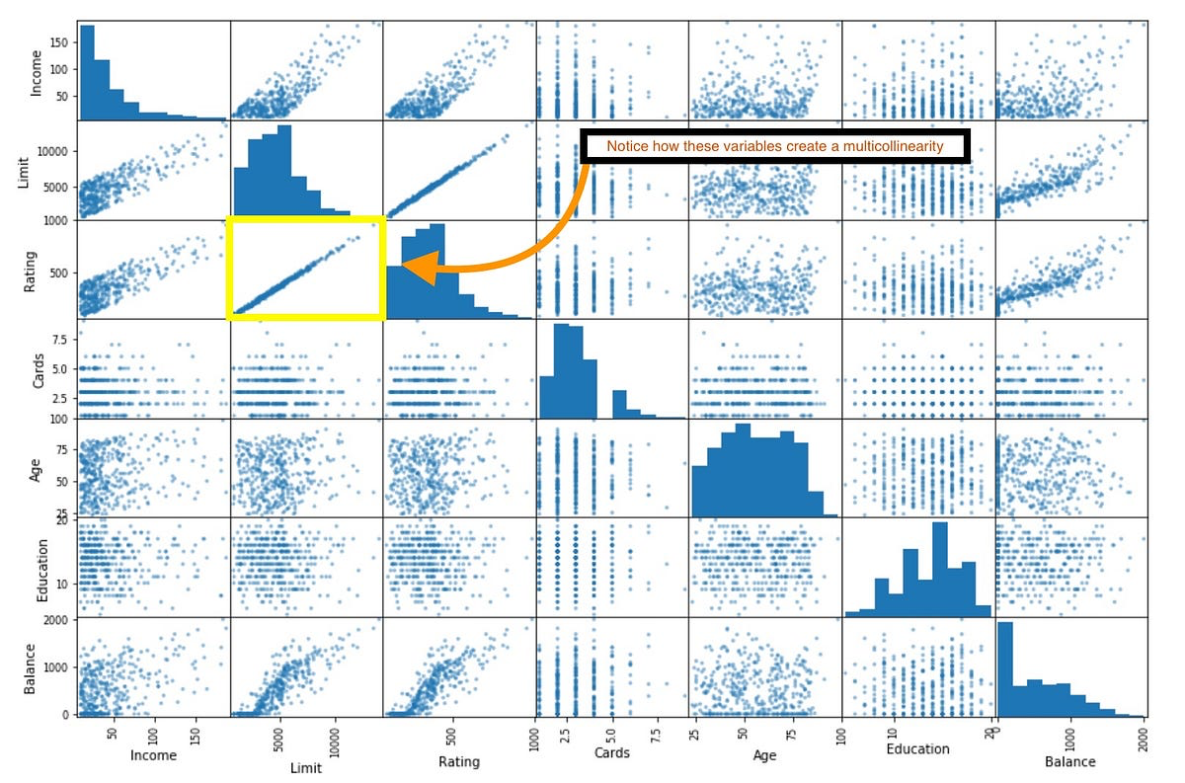
Multicollinearity
Notes:
Guidelines
Use a title slide at the beginning of your presentation. There are 9 variations of title slides to choose from.
If you will have a series of slideshows, we recommend using the same style of title slide for each presentation.
Keep your title to no more than 2 lines.
Do not change the font style or font size of the title or subtitle.

Slide 3
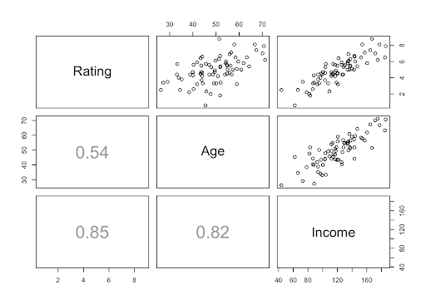
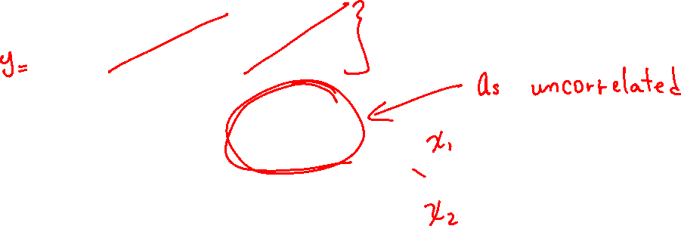
Multicollineary (collinearity)
is a situation where the predictors are linearly correlated.

Slide 4
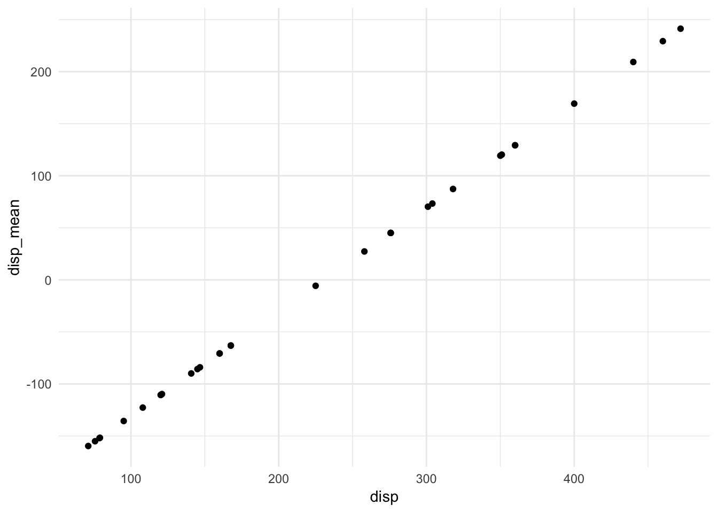
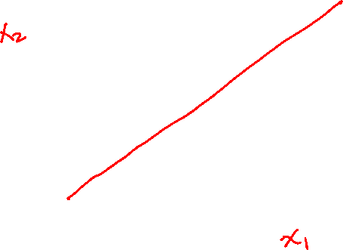
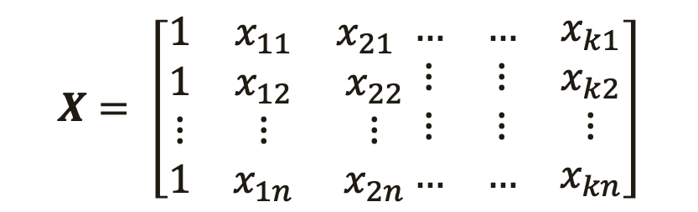
Perfect Collinearity
Refers to predictors that are linearly dependent
$$X= \left[\begin{matrix}1 & x_{11} & x_{21} \\ 1 & x_{12} & x_{22} \\ ⋮ & ⋮ & ⋮ \\ 1 & x_{1n} & x_{2n}\end{matrix}\begin{matrix}… & … & x_{k1} \\ ⋮ & ⋮ & x_{k2} \\ ⋮ & ⋮ & ⋮ \\ … & … & x_{kn}\end{matrix}\right]$$
linear combination

Slide 5
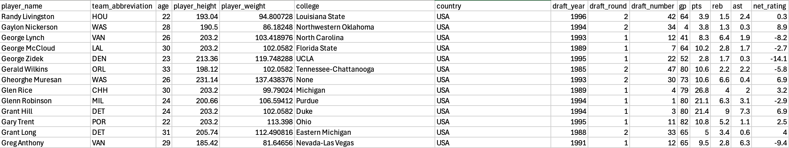
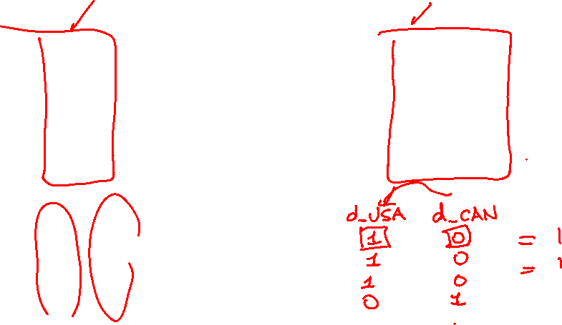
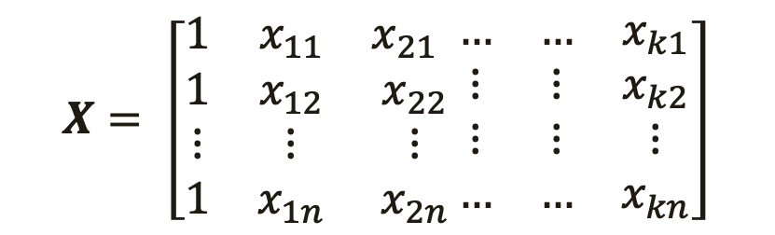
Perfect Collinearity
Refers to predictors that are linearly dependent
$$X= \left[\begin{matrix}1 & x_{11} & x_{21} \\ 1 & x_{12} & x_{22} \\ ⋮ & ⋮ & ⋮ \\ 1 & x_{1n} & x_{2n}\end{matrix}\begin{matrix}… & … & x_{k1} \\ ⋮ & ⋮ & x_{k2} \\ ⋮ & ⋮ & ⋮ \\ … & … & x_{kn}\end{matrix}\right]$$

Slide 6
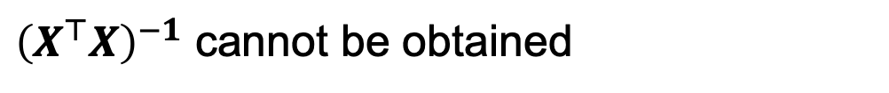
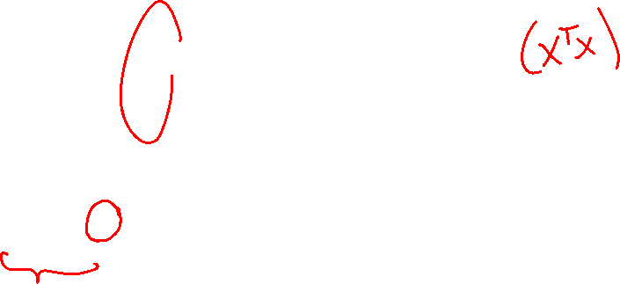
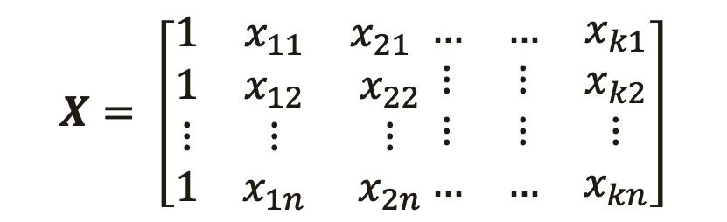
Perfect Collinearity
Refers to predictors that are linearly dependent
$$X= \left[\begin{matrix}1 & x_{11} & x_{21} \\ 1 & x_{12} & x_{22} \\ ⋮ & ⋮ & ⋮ \\ 1 & x_{1n} & x_{2n}\end{matrix}\begin{matrix}… & … & x_{k1} \\ ⋮ & ⋮ & x_{k2} \\ ⋮ & ⋮ & ⋮ \\ … & … & x_{kn}\end{matrix}\right]$$
${\left(X^{⊤}X\right)}^{−1}$ cannot be obtained

Slide 7

Practice

Slide 8
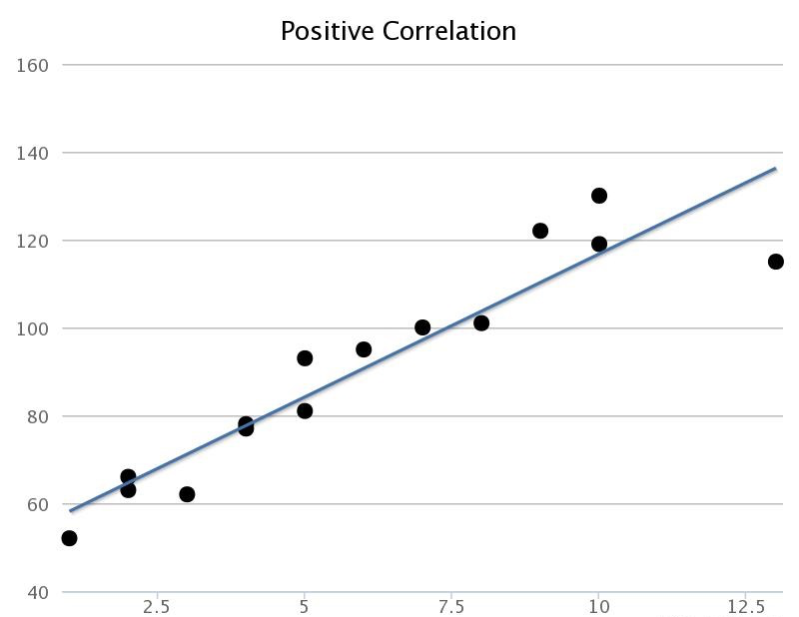
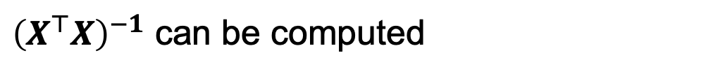
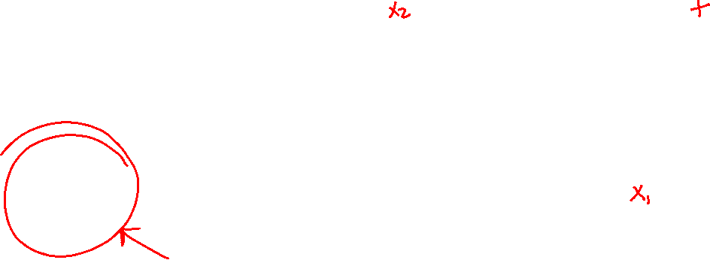
Near Perfect Collinearity
Refers to predictors that very correlated but not perfectly
$$X= \left[\begin{matrix}1 & x_{11} & x_{21} \\ 1 & x_{12} & x_{22} \\ ⋮ & ⋮ & ⋮ \\ 1 & x_{1n} & x_{2n}\end{matrix}\begin{matrix}… & … & x_{k1} \\ ⋮ & ⋮ & x_{k2} \\ ⋮ & ⋮ & ⋮ \\ … & … & x_{kn}\end{matrix}\right]$$
${\left(X^{⊤}X\right)}^{−1}$ can be computed

Slide 9
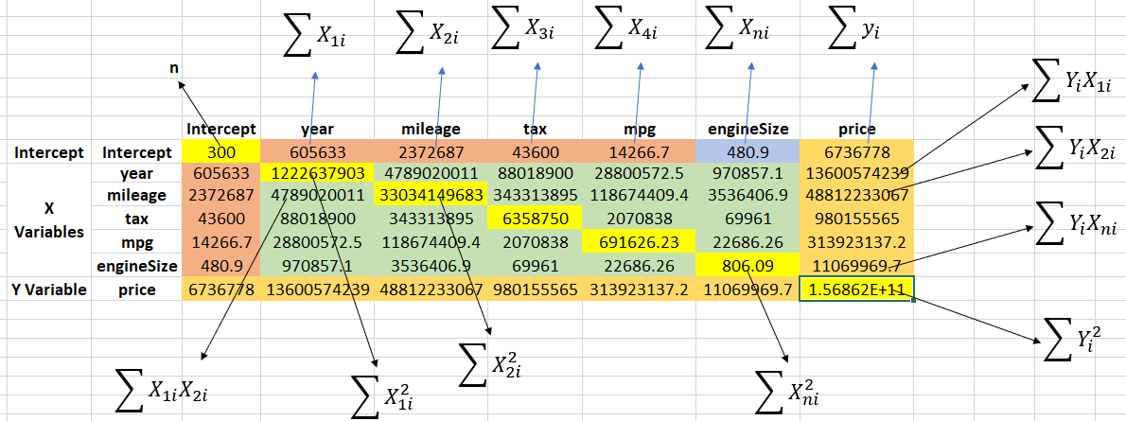

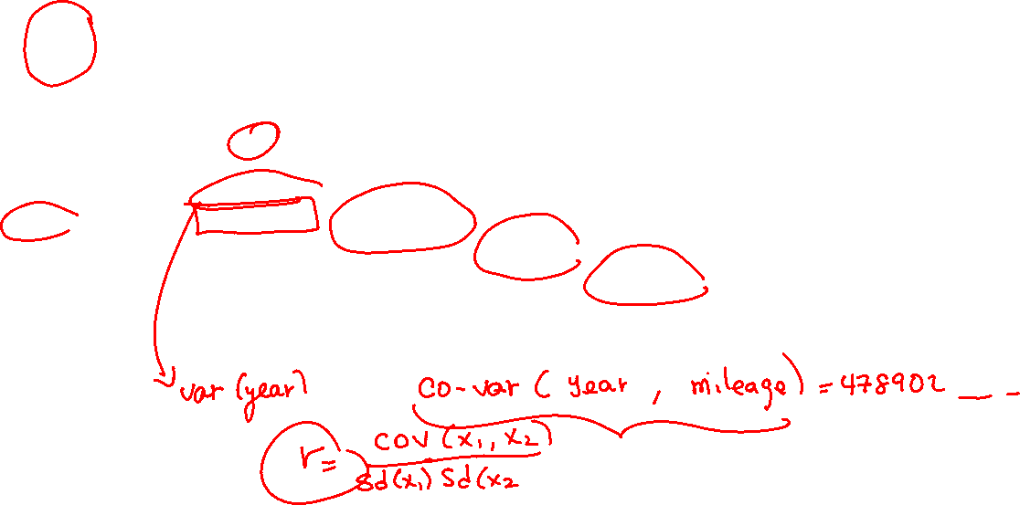
Near Perfect Collinearity
$X^{⊤}X$ contains information about variances and covariances

Slide 10
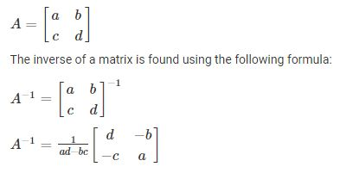

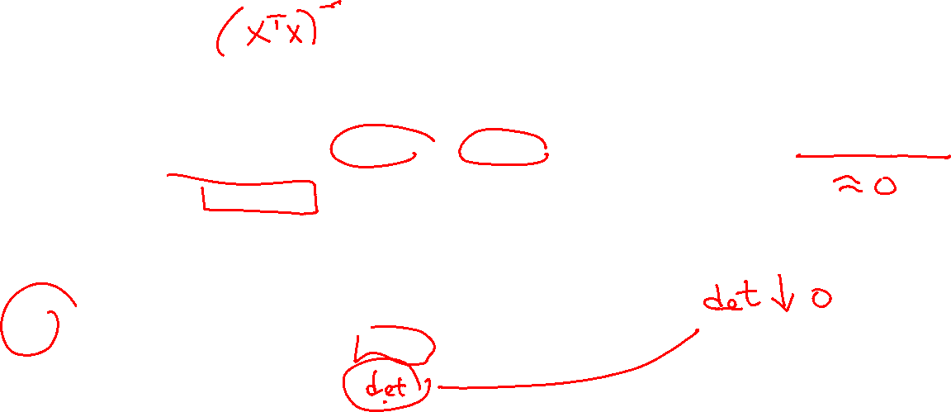
Near Perfect Collinearity
One of the steps to obtain ${\left(X^{⊤}X\right)}^{−1}$ is to divide by the determinant

Slide 11

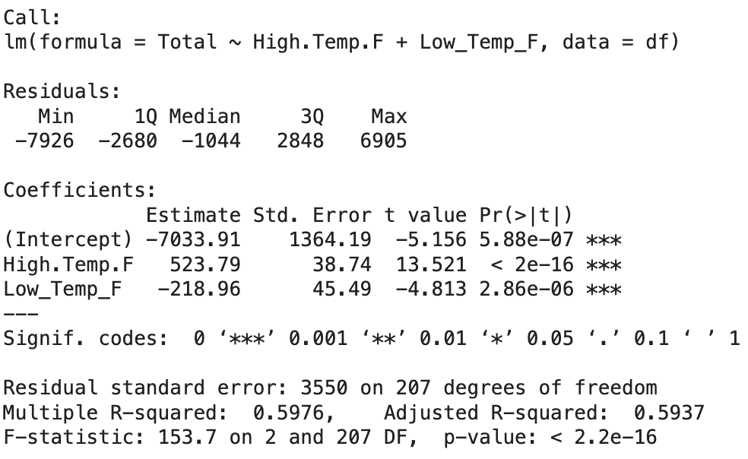
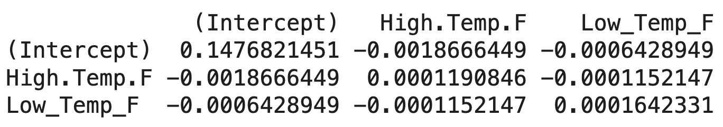
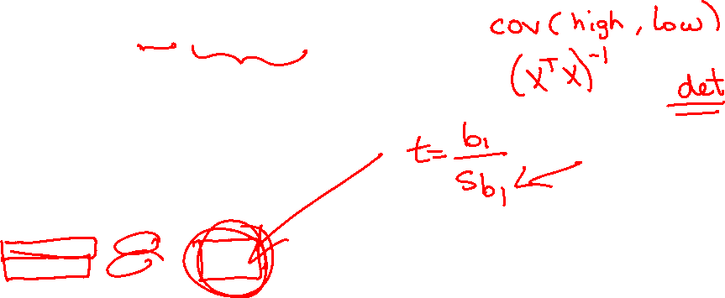

Standard Error of Estimates
Standard Errors estimates how the estimates vary.
$${\left(X^{⊤}X\right)}^{−1}$$

Slide 12
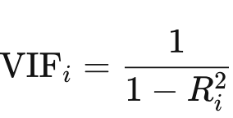
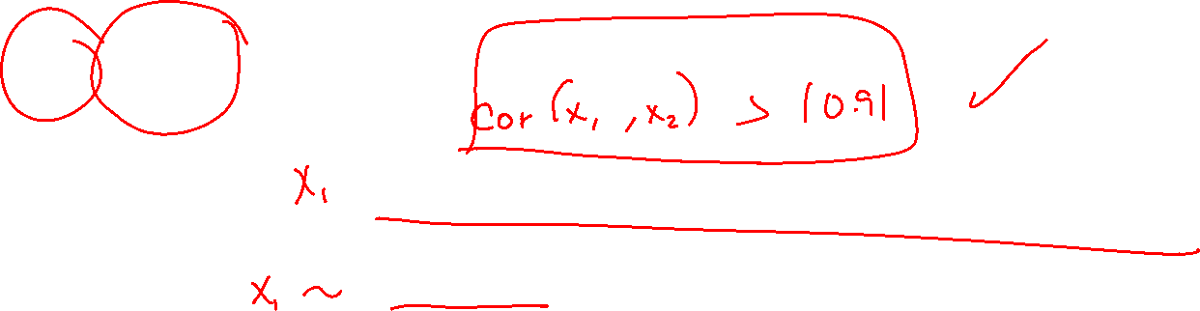
Variance Inflation Factor
A measure of the amount of multicollinearity in regression analysis
Calculated for each predictor
A VIF greater than 10 is indicative of high multicollinearity

Slide 13
What to do About Multicollinearity?
Most of the times no action is needed.
Know that there is more variability (uncertainty) on the estimates
Interpretations might be hard to justify

Slide 14
Practice

